Slide 1
CORE Python
By – Shivam
Date – 14/15th June 2018
Venue – Accenture

Slide 2
Introduction to Python
Python is an interpreted high-level programming language for general-purpose programming
Created by “Guido van Rossum” (Dutch Programmer) and first released in 1991
Currently maintained by PSF (Python Software Foundation)
There are two major Python versions- Python 2.x and Python 3.x

Slide 3
WHY PYTHON ?
Interpreter Language
Powerful & flexible
High level language
Readability
Easy to learn & use
Great support from community & a large pool of third party library
Open Source & free to use

Slide 4
WHY PYTHON ?
Cross platform or Platform independent
Rapid prototyping & development
Portability (develop anywhere, deploy anywhere)
Multi purpose –
Web Application (Flask/Django/ Bottle)
IoT
Data Science, Machine Learning, Predictive Analysis
Hacking (Pen Testing)
GUI Development (Tkinter)

Slide 5
Python Flavors
Cython – The base python that we all use, build on C language
Jython – Python running on Java Virtual Environment
IronPython – Python running on .NET
Stackless Python – for lightweight threading, for supporting micro threading
MicroPython – Running on microcontrollers

Slide 6
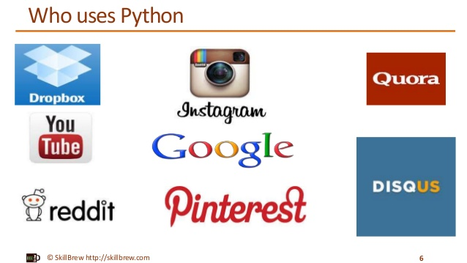
WHO Uses Python ?
Google
YouTube
Quora
Dropbox
Instagram
Spotify
Reddit
Bit Torrent
NASA
Pixar

Slide 7
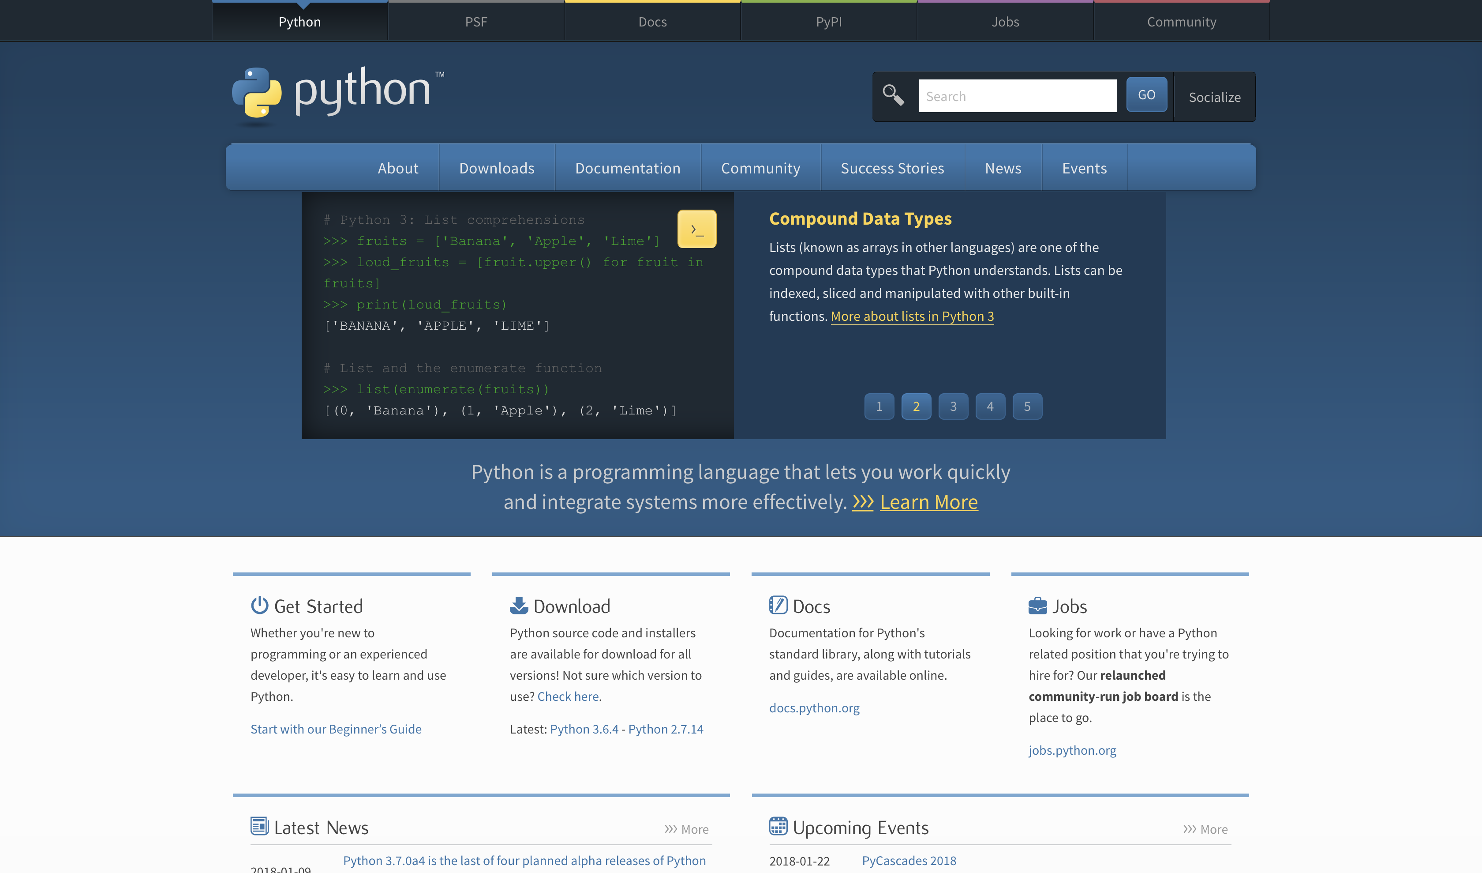
Download Python
Open https://www.python.org
Navigate to Downloads tab in Carousal
Select your OS and download python 3.x
Traverse the website, it’s really useful

Slide 8
ACCESS python
How to access python on command line ?
python -V #Check the version of python
IDE – Integrated Development Environment
Example – IDLE, Spyder, PyCharm, Jupyter

Slide 9
Hello World
print(“Hello Class !!!”)
Hello Class !!!
Swapping of two numbers –
a = 10
b = 20
b, a = a, b
Search item in list –
a = [12, 96, 45, 77, 32, 21]
b = 45
b in a

Slide 10
Declare a Variable
my_name = “Shivam”
py_version = 35
my_cgpa = 9.2
Can contain number but should not start with a number
“version_7” is valid but “7_version” is not !
Can contain (_) underscore and not (-)
Special characters can’t be used in variables too
Cant use system defined variable example __self__

Slide 11
RESERVED KEYWORDS
and elif import return
as else in try
assert except is while
break finally lambda with
class for not yield
or from continue
def global pass
del if raise

Slide 12
COMMENTS in PYTHON
Used in legal foot-printing/ disclaimer, debugging, doc strings, TODO
Single line comments are with # (Hash, pound, octothorpe)
‘ ‘ ‘
Triple quotes – Multi line comments / Strings in Code
’ ’ ’

Slide 13
Data Type
Strings - str
Integers - int
Float - float
List - list
Dictionary - dict
Tuple – tuple
Check data type with type() or isinstance()

Slide 14
String
Data type – str
String are immutable, i.e. they cant be modified once created
my_string = “My name is Shivam”
len(my_string)

Slide 15
String
len(my_str) Returns the length of the string
my_str + “python” Concatenation of strings
my_str * 5 Repetition of strings
str(55) Type casting of string

Slide 16
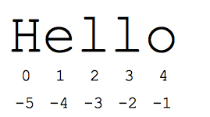
STRING
String index
a = “Hello”
a[0] = “H”
a[1] = “e”
Negative Index
a[-1] = “o”
a[-2] = “l”

Slide 17
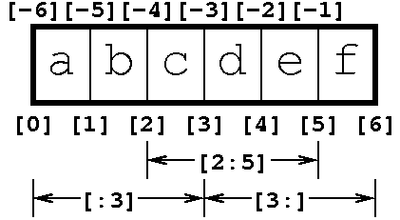
STRING
String Slicing
a = “abcdef”
a[start:end] # items start through end-1
a[start:] # items start through the rest of the array
a[:end] # items from the beginning through end-1
a[:] # a copy of the whole array

Slide 18
STRING
a[start: end: step] # start through not past end, by step
a[2:5:2] “lo”
a[::-1] # all items in the array, reversed

Slide 19
Integer
Data type – int
Immutable in nature
my_number = 98
type(my_number)
Arithmetic Operations
my_number * 2

Slide 20
Float
Data type – float
Immutable in nature
my_float_num = 3.14
type(my_float_num)
Arithmetic Operations
my_float_num * 3

Slide 21
LIST
Data type – list [ ]
Mutable Objects – Can be modified on runtime
Ordered set of data
Collection of different data types
my_list = [“Python”, 25, 3.14]
len(my_list)

Slide 22
LIST
my_list.append()
my_list.extend()
my_list.index()
my_list.count()
my_list.insert(index, item)
my_list.pop(index)
my_list.remove(item)
my_list.reverse()
my_list.sort()

Slide 23
LIST Indexing
my_list = [“a”, “b”, “c”, “d”, “e”]
my_list[0]
my_list[3]
my_list[-1]
my_list[-2]

Slide 24
LIST SLICING
my_list[3:]
my_list[:3]
my_list[:]
my_list[::2]

Slide 25
TUPLE
Data type – tuple ( )
Immutable Objects
Ordered set of data
Collection of different data types
my_tuple = (“Google”, 92, 2.7132)
len(my_tuple)

Slide 26
TUPLE
my_tuple.index()
my_tuple.count()
Use –
ordered data,
static data,
protection against over writing,
different data type,
read only,
faster

Slide 27
PACKING UNPACKING OF TUPLE & LIST
Tuple can be made by
my_tuple = “Shivam”, 9.28, 25
my_tuple = [“Shivam”, 9.28, 25]
name, gpa, age = my_tuple

Slide 28
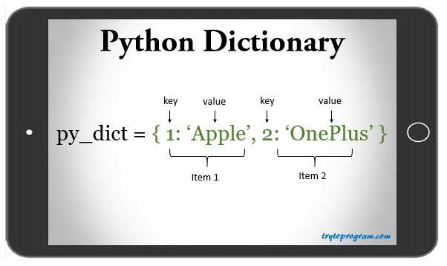
dictionary
Data type – dict {“ ”: } – key value pair
Mutable Objects
Unordered set of data
Collection of different data types
my_dict = {“Company”: “Accenture”, “Address”: “Tech Park”}
Use –
For storing key values
Faster, because each value is associated to a key & key is running through a hash function

Slide 29
dictionary
my_dict.clear()
my_dict.get()
my_dict.keys()
my_dict.values()
my_dict.items()
my_dict.pop(key)
my_dict.updte(another dictionary)

Slide 30
DICTIONARY
Update value for a particular key
my_dict[“some_key”] = “some_value”
No Slicing or Indexing as they are unordered

Slide 31
HELP IN PYTHON
help() function
https://docs.python.org/3.6/tutorial/

Slide 32
OPERATOR
+ - * /
< , >
% Only Remainder
// Floor division, discards the fraction part
** Power
== Check equality
!= Not equal to
AND, OR, NOT
Order of operation PEMDAS (parenthesis, exponential, multi, division, add, sub)

Slide 33
OPERATOR
Division always returns a float value
% - Modulus returns the remainder of the division 100 % 10
// for getting quotient
= is assignment where as == is for checking
Boolean Logic { George Boole 1815 – 1864 } British Mathematician
X or Y
X and Y

Slide 34
INPUT RAW DATA
num = input(“Enter a number : ”)
Check data type of number

Slide 35
TYPE CASTING
Dictionary to list, it will only contain keys and no values.
Float to int, will only contain whole number and not decimal
Tuple to list
List to tuple

Slide 36
STRING Manipulation
a = “Hello”
a.find(“e”)
a.replace()
a.split()
a.center(10, “*”)
a.count(“l”)
a.split()
“ ”.join(str)

Slide 37
STRING Manipulation
a.upper()
a.lower()
a. capitalize()
a.isupper()
a.islower()

Slide 38
STRING FORMATTING
C type
“%s has %f marks” % (“Shivam”, 9.28)
%s – string %d – integer %f – float %c – single character
Method Call ( Python 3.x)
“{0} has {1} gaming stations”.format(“Shivam”, 3)
always starts from zero
Can use variables too
%.2f – float formatting till 2 digits

Slide 39
CONDITIONAL STATEMENT
if
Use of indentation and : after the end of logic
a = 30
if a == 30:
print(“a is 30”)
if-else
if a == 40:
print(“a is 40”)
else:
print(“a is not 40”)
Do this same for a string comparison (static login page)

Slide 40
CONDITIONAL STATEMENT
elif example
x = int(input("Please enter an integer: "))
if x < 0:
print(‘Number less than zero')
elif x == 0:
print('Zero')
elif x == 1:
print('Single')
else:
print(‘Positive Natural Number other than 1 ')

Slide 41
CONDITIONAL STATEMENT
Nested If-else
if day == “weekday”:
if total >= 150:
print(“Will get 10% discount”)
else:
print(“No discount on less than 150 on weekdays”)
elif day == “weekend”:
if total >=100:
print(“Will get 10% discount”)
else:
print(“No discount on less than 100 on weekends”)

Slide 42
Looping
for loop
range function – range(10), range(3, 6), range(4, 10, 2 ) (enclose in list in py3.x)
for i in range(10):
print(i)

Slide 43
Looping
for loop on iterable – (list, tuple, dict, str)
for item in range(len(my_list)):
print(item)
for item in my_list:
print(item)
ZIP Function

Slide 44
Looping
while –
a = 10
while a < 15:
print(a)
a = a + 1
while True:

Slide 45
Control STATEMENT
break
continue
pass
def my_function_for_nothing():
""“
Do nothing, but document it.
No, really, it doesn't do anything.
"""
pass

Slide 46
LIST COMPREHENSIONS
[i for i in my_list]
[i for i in range(10) if i % 5==0]

Slide 47
FUNCTION
Block of code that performs a specific action and return a specific result
Advantage –
Reusable Code
Easier to maintain
Increase readability
Hide complexity from user
name = my_function(arg1, arg2, arg3=“default_value”)

Slide 48
Function
def, arguments, return,
def addition(a, b):
c = a+ b
return c
Global Variables

Slide 49
lambda
my_sum = lambda(a,b : a +b)
my_sum(10, 17)

Slide 50
I/O Input Output
Create a notepad file in D Drive
f = open(“D:\\filename.txt”)
with open(“D:\\filename.txt”) as _file:
file_content = _file.read()
read()
readline()
readlines()
PICKLE

Slide 51
EXCEPTION HANDLING
try:
a = “Shivam” + 5
except as e:
print(“Error is - ”, e)
---------------------------------------------------------------
try:
print 1/0
except ZeroDivisionError:
print "You can't divide by zero, you're silly."

Slide 52
BEST PRACTISES IN PYHTON
Use 4-space indentation, and no tabs.
4 spaces are a good compromise between small indentation (allows greater nesting depth) and large indentation (easier to read). Tabs introduce confusion, and are best left out.
Wrap lines so that they don’t exceed 79 characters.
This helps users with small displays and makes it possible to have several code files side-by-side on larger displays.
Use blank lines to separate functions and classes, and larger blocks of code inside functions.

Slide 53
BEST PRACTISES IN PYHTON
When possible, put comments on a line of their own.
Use docstrings.
Use spaces around operators and after commas, but not directly inside bracketing constructs: a = f(1, 2) + g(3, 4).
Name your functions consistently; the convention is to use CamelCase for classes and lower_case_with_underscores for functions and methods. Always use self as the name for the first method argument (see A First Look at Classes for more on classes and methods).
Don’t use fancy encodings if your code is meant to be used in international environments. Python’s default, UTF-8, or even plain ASCII work best in any case.
Likewise, don’t use non-ASCII characters in identifiers if there is only the slightest chance people speaking a different language will read or maintain the code.

Slide 54
Q & A
Question 1: - Which data types are immutable?
Answer: -

Slide 55
Question 2 :– Is python case sensitive ?
Answer

Slide 56
Question 3 :- hometown = “California”
What is hometown[2:5] ?

Slide 57
Question 4: - my_str = “Hello Python”
What is my_str * 3 ?

Slide 58
Question 5 :- my_list = [“abcd”, 789, 2.23, “john”, (1,5,6,8)]
What is my_list[3::2] ?

Slide 59
Question 6 :- Difference in tuple in list?
Answer

Slide 60
Question 7:- tinytuple = (2,4.5)
What is tinytuple *2 ?

Slide 61
Question 8 :- alist1 = [2, 4, 6] alist2 = [10,13,14]
What is alist1 + alist2 ?

Slide 62
Question 9 :- Your grades somehow in Database got into string ?
grade = “9.82”
Convert it back to integer ?

Slide 63
Question 10:- Write down example and definition of % and // ?

Slide 64
Question 11:- Sort a list
my_list = [“Accenture”, “Green”, 34, 56, 32]

Slide 65
Question 12:- my_list = [“Accenture”, “Green”, 34, 56, 32]
Write code to remove 56 as an item in my_list ?

Slide 66
Question 13:- my_list = [“Accenture”, “Green”, 34, 56, 32]
Find the index of 32 and now delete that from list ?

Slide 67

THANK YOU

